Slide 1
Network : Overview
Jae Hyeon Kim

Slide 2
Reference
William Stalling, Data and Computer Communications 10/E, Prentice Hall

Slide 3
Data Communications & Data Networking
“The fundamental problem of communication is that of reproducing at one point either exactly or approximately a message selected at another point”
The Mathematical Theory of Communication,
Claude Shannon

Slide 4
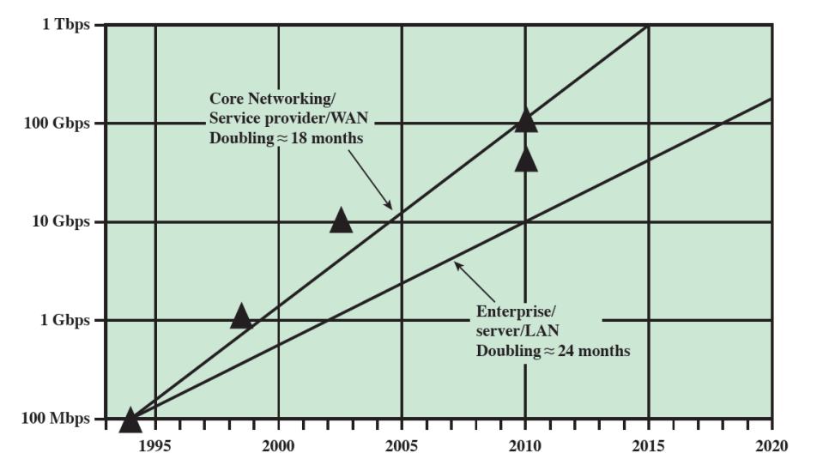
Notable Technology Trends
Faster and cheaper in both computing and communication
More powerful computers supporting more demanding applications
The increasing use of optical fiber and high-speed wireless has brought transmission prices down and greatly increased capacity

Slide 5
Notable Technology Trends
Today’s networks are more “intelligent”
Differing levels of quality of service (QoS)
Variety of customize services of network management and security
Internet, Web, and associated applications have emerged as dominant features for both business and personal network
“everything over IP”
Mobility
Smart devices became drivers of the evolution of business networks
Enterprise applications are now routinely delivered on mobile devices
Cloud computing is being embraced

Slide 6
Key Communications Tasks
Transmission system utilization
Interfacing
Signal generation
Synchronization
Exchange management
Error detection and correction
Addressing and routing
Recovery

Slide 7
Key Communications Tasks
Message formatting
Security
Network management

Slide 8
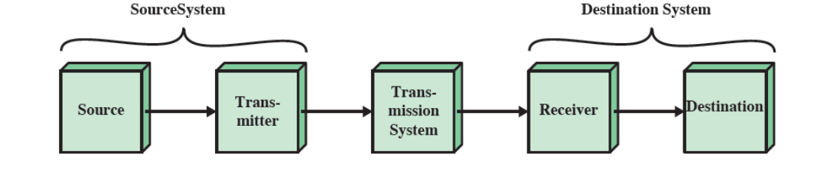
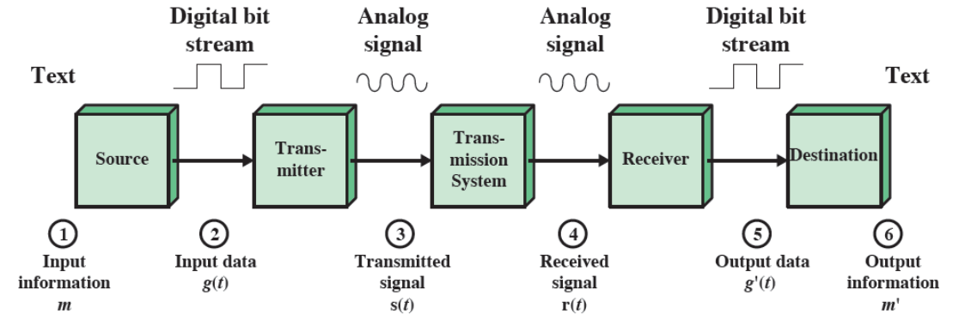
Data Communication Model
Simplified communications model
Simplified data communications model

Slide 9
Transmission Lines and Medias
The transmission line is the basic building block of any communications facility
The business manager is concerned with a facility providing
The required capacity
With acceptable reliability
At minimum cost
Two transmission mediums are currently driving the evolution of data communications
Fiber optic transmissions
Wireless transmissions

Slide 10
Why Data Networking
Background
Growth of computer is driving need for interconnection
Larger set of devices may need impractical number of connections
Point to point communication not usually practical, why?
A group of computers would be usually getting together in the same location
Digital data delivery is inherently in intermittent pattern, in contrary of analog data
Solution is a communications network
Wide Area Network (WAN)
Local Area Network (LAN)

Slide 11
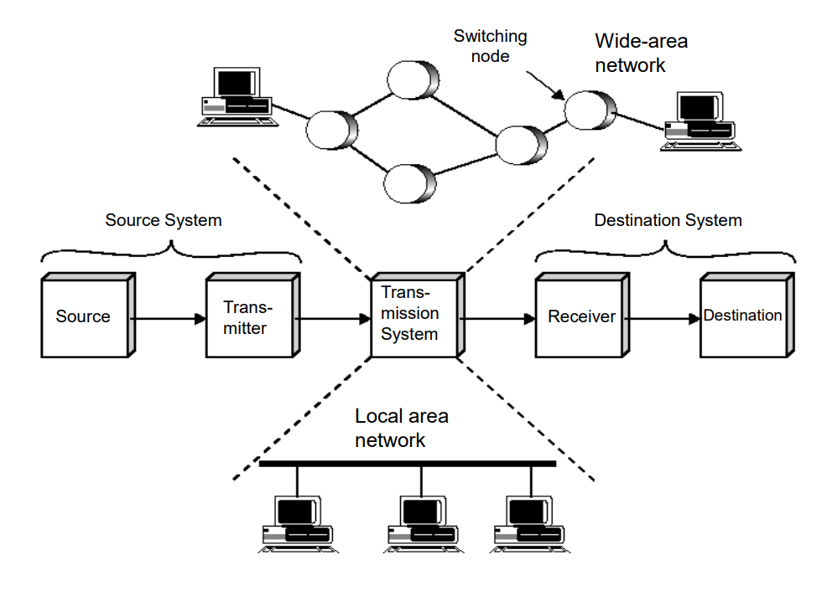
Simplified Network Model

Slide 12
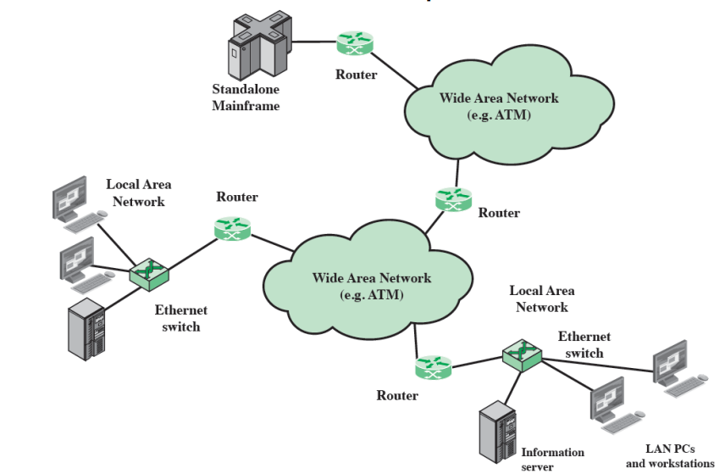
The Internet
Internet evolved from ARPANET
Developed to solve the dilemma of communicating across arbitrary, multiple, packet-switched network
Foundation is the TCP/IP protocol suite

